Slide 1
Course Code: AID354 Course: Dependable AI
UNIT I

Slide 2
Credits: 3-0-0
In Semester Examination-I: 15 Marks
In Semester Examination-II: 15 Marks
Continuous In-semester Evaluation: 10 Marks
Teacher Assessment: 10 Marks
End Semester Examination: 50 Marks
End Semester Examination (Duration): 02 Hrs

Slide 3
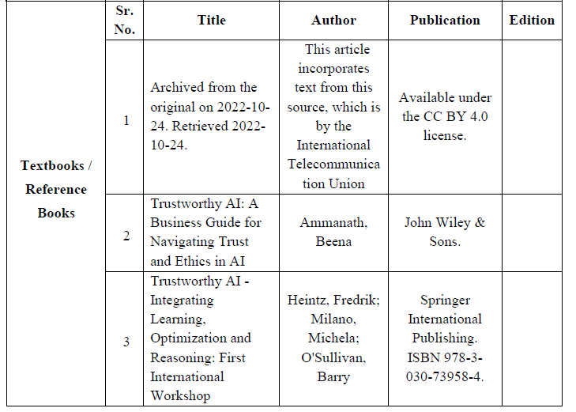
Textbook and References

Slide 4
Course Objectives:
1. Introduction to Dependable AI (Types, Use, factors, challenges)
2. Defining AI transparency (Nature, limits, trust, and security)]
3. Understanding explainable AI technical approaches
4. getting acquainted with Accountable AI laws and liability.
5. Understanding the Corporate AI responsibility.
6. Identify Trustworthy practices in AI.

Slide 5
Unit I: Introduction to Dependable AI Syllabus
Types of AI models and Use cases,
new challenges for modern AI era,
a longstanding ethical question,
tradeoffs in fairness,
Robust and Reliable AI,
The challenges of generalizable Deep Learning,
factors affecting AI reliability

Slide 6
Engineering Applications of Artificial Intelligence
1: Advanced Robot: advanced robots in automobile manufacturing
2: Big Data: detecting mistakes and formulating solutions through ML
3: Internet of Things: monitor projects remotely example IOT sensors.
4: Image Processing: Decision-making through sensors. identify hidden structural deformities.
5: Natural Language Processing: allowing machines and humans to communicate

Slide 7
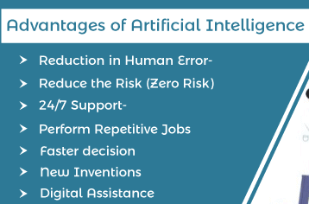
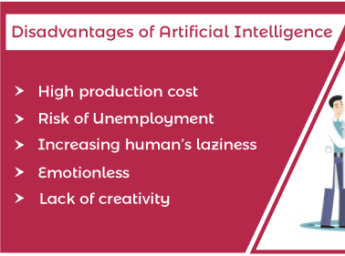
Advantage and Disadvantage of AI

Slide 8
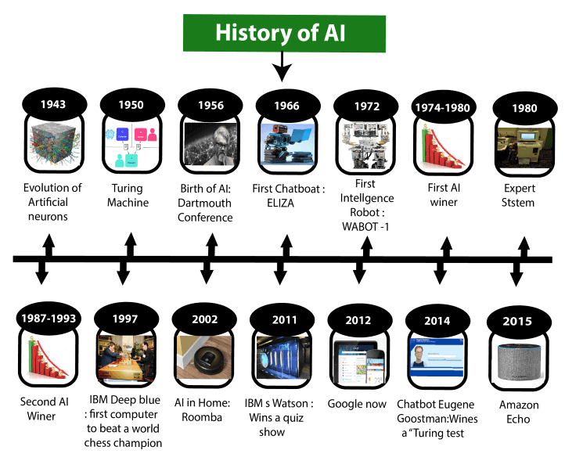
History of AI: some milestones

Slide 9
Maturation of Artificial Intelligence
Year 1943: The first work which is now recognized as AI was done by Warren McCulloch and Walter pits in 1943. They proposed a model of artificial neurons.
Year 1949: Donald Hebb demonstrated an updating rule for modifying the connection strength between neurons. His rule is now called Hebbian learning.
Year 1950: The Alan Turing proposed a test. The test can check the machine's ability to exhibit intelligent behavior equivalent to human intelligence, called a Turing test.
Year 1955: An Allen Newell and Herbert A. Simon created the "first artificial intelligence program"Which was named as "Logic Theorist". This program had proved 38 of 52 Mathematics theorems, and find new and more elegant proofs for some theorems.
Year 1956: AI coined as an academic field.
Year 1966: Joseph Weizenbaum created the first chatbot in 1966, which was named as ELIZA.
Year 1972: The first intelligent humanoid robot was built in Japan which was named as WABOT-1.
Year 1980: Expert systems were programmed that emulate the decision-making ability of a human expert.

Slide 10
The emergence of intelligent agents (1993-2011)
Year 1997: In the year 1997, IBM Deep Blue beats world chess champion, Gary Kasparov, and became the first computer to beat a world chess champion.
Year 2002: for the first time, AI entered the home in the form of Roomba, a vacuum cleaner.
Year 2006: AI came in the Business world till the year 2006. Companies like Facebook, Twitter, and Netflix also started using AI.
Deep learning, big data and artificial general intelligence (2011-present)
Year 2011: In the year 2011, IBM's Watson won jeopardy, a quiz show, where it had to solve the complex questions as well as riddles. Watson had proved that it could understand natural language and can solve tricky questions quickly.
Year 2012: Google has launched an Android app feature "Google now", which was able to provide information to the user as a prediction.
Year 2014: In the year 2014, Chatbot "Eugene Goostman" won a competition in the infamous "Turing test."
Year 2018: The "Project Debater" from IBM debated on complex topics with two master debaters and also performed extremely well.
Google has demonstrated an AI program "Duplex" which was a virtual assistant and which had taken hairdresser appointment on call, and lady on other side didn't notice that she was talking with the machine.

Slide 11
different types of artificial intelligence
1. 1. Artificial Narrow AI
Artificial Narrow Intelligence, also known as Weak AI, what we refer to as Narrow AI is the only type of AI that exists today. Any other form of AI is theoretical. It can be trained to perform a single or narrow task, often far faster and better than a human mind can. However, it can’t perform outside of its defined task. Instead, it targets a single subset of cognitive abilities and advances in that spectrum. Siri, Amazon’s Alexa and IBM Watson are examples of Narrow AI. Even OpenAI’s ChatGPT is considered a form of Narrow AI because it’s limited to the single task of text-based chat.
2. General AI
Artificial General Intelligence (AGI), also known as Strong AI, is today nothing more than a theoretical concept. AGI can use previous learnings and skills to accomplish new tasks in a different context without the need for human beings to train the underlying models. This ability allows AGI to learn and perform any intellectual task that a human being can.
3. Super AI
Super AI is commonly referred to as artificial superintelligence and, like AGI, is strictly theoretical. If ever realized, Super AI would think, reason, learn, make judgements and possess cognitive abilities that surpass those of human beings. The applications possessing Super AI capabilities will have evolved beyond the point of understanding human sentiments and experiences to feel emotions, have needs and possess beliefs and desires of their own.

Slide 12
The four types of AI based on functionalities
1. . Reactive Machine AI
Reactive machines are AI systems with no memory and are designed to perform a very specific task. Since they can’t recollect previous outcomes or decisions, they only work with presently available data. Reactive AI stems from statistical math and can analyze vast amounts of data to produce a seemingly intelligence output.
Examples of Reactive Machine AI
IBM Deep Blue: IBM’s chess-playing supercomputer AI beat chess grandmaster Garry Kasparov in the late 1990s by analyzing the pieces on the board and predicting the probable outcomes of each move
The Netflix Recommendation Engine: Netflix’s viewing recommendations are powered by models that process data sets collected from viewing history to provide customers with content they’re most likely to enjoy

Slide 13
2. Limited Memory AI
Unlike Reactive Machine AI, this form of AI can recall past events and outcomes and monitor specific objects or situations over time. Limited Memory AI can use past- and present-moment data to decide on a course of action most likely to help achieve a desired outcome. However, while Limited Memory AI can use past data for a specific amount of time, it can’t retain that data in a library of past experiences to use over a long-term period. As it’s trained on more data over time, Limited Memory AI can improve in performance.
Examples of Limited Memory AI
Generative AI: Generative AI tools such as ChatGPT, Bard and DeepAI rely on limited memory AI capabilities to predict the next word, phrase or visual element within the content it’s generating
Virtual assistants and chatbots: Siri, Alexa, Google Assistant, Cortana and IBM Watson Assistant combine natural language processing (NLP) and Limited Memory AI to understand questions and requests, take appropriate actions and compose responses
Self-driving cars: Autonomous vehicles use Limited Memory AI to understand the world around them in real-time and make informed decisions on when to apply speed, brake, make a turn, etc.

Slide 14
3. Theory of Mind AI
Theory of Mind AI is a functional class of AI that falls underneath the General AI. Though an unrealized form of AI today, AI with Theory of Mind functionality would understand the thoughts and emotions of other entities. This understanding can affect how the AI interacts with those around them. In theory, this would allow the AI to simulate human-like relationships. Because Theory of Mind AI could infer human motives and reasoning, it would personalize its interactions with individuals based on their unique emotional needs and intentions. Theory of Mind AI would also be able to understand and contextualize artwork and essays, which today’s generative AI tools are unable to do.
Emotion AI is a theory of mind AI currently in development. AI researchers hope it will have the ability to analyze voices, images and other kinds of data to recognize, simulate, monitor and respond appropriately to humans on an emotional level. To date, Emotion AI is unable to understand and respond to human feelings.

Slide 15
4. Self-Aware AI
Self-Aware AI is a kind of functional AI class for applications that would possess super AI capabilities. Like theory of mind AI, Self-Aware AI is strictly theoretical. If ever achieved, it would have the ability to understand its own internal conditions and traits along with human emotions and thoughts. It would also have its own set of emotions, needs and beliefs.
Emotion AI is a Theory of Mind AI currently in development. Researchers hope it will have the ability to analyze voices, images and other kinds of data to recognize, simulate, monitor and respond appropriately to humans on an emotional level. To date, Emotion AI is unable to understand and respond to human feelings.

Slide 16
Practical Applications Of AI Technologies
1. Computer vision : Narrow AI applications with computer vision can be trained to interpret and analyze the visual world. This allows intelligent machines to identify and classify objects within images and video footage.
Applications of computer vision include:
Image recognition and classification
Object detection
Object tracking
Facial recognition
Content-based image retrieval
Ex. self-driving cars and machines navigating warehouses and other environments.
2. Robotics
Robots in industrial settings can use Narrow AI to perform routine, repetitive tasks
It involves materials handling, assembly, and quality inspections.
In healthcare used to assist surgeons in detecting issues during procedures.
Agricultural machines can engage in autonomous pruning, moving, thinning, seeding and spraying.
And smart home devices such as the iRobot Roomba can navigate a home’s interior using computer vision and use data stored in memory to understand its progress.
3. Expert systems
Expert systems equipped with Narrow AI capabilities can be trained to emulate the human decision-making process
apply expertise to solve complex problems.
These systems can evaluate vast amounts of data to uncover trends and patterns to make decisions.
They can also help businesses predict future events and understand why past events occurred.

Slide 17
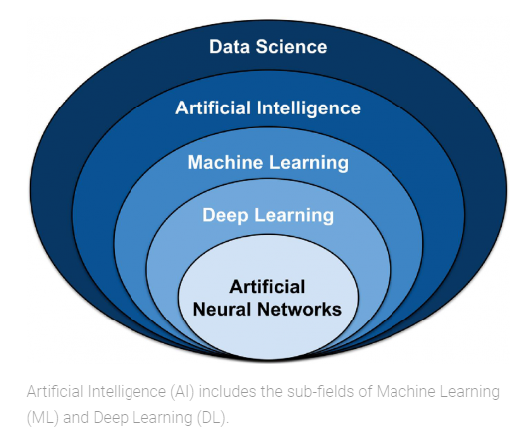
AI , ML and Deep learning

Slide 18
Artificial Intelligence (AI) | Machine Learning (ML):Machine Learning (ML) is a subset of AI that gives machines the ability to learn from experience. Programming explicitly is not needed. In ML learning types are supervised, unsupervised learning and a hybrid version named semi-supervised learning. |  | Deep Learning: a DL model is a neural network that has been trained to learn how to perform a task. ex. recognizing objects in images and videos or understanding human speech.
 | Supervised | Unsupervised
(AI) is a subfield within computer science associated with constructing machines that can simulate human intelligence. AI research deals with the question of how to create computers that are capable of intelligent behavior | In short, supervised learning is where the algorithm is given a set of training data. from ground truth data that was labeled manually by data scientists. In computer vision, this process is called image annotation. The model uses this data to learn (AI training) how to make predictions on new data (AI inferencing). | unsupervised learning is where the algorithm is given raw data that is not annotated. algorithm is not explicitly told what to do with it and must learn how to make predictions by itself. ex. fraud detection or financial analysis, that require identifying a hidden structure in unlabeled data. | Deep learning models are trained by using large sets of data and algorithms. The more data the model is trained on, the better it can learn to perform the task. The term “deep” of “deep learning” refers to the fact that DL models are composed of multiple layers of neurons, or processing nodes. The deeper the model, the more layers of neurons it has. This allows the model to learn more complex tasks by breaking them down into smaller and smaller pieces. The deepest models currently available For example, ResNet for computer vision with a version that contains 152 layers (ResNet-152).

Slide 19
Types of AI Models:
List of the Most Popular AI Model types AI Model
1. Large Language Models (LLM)
2. Deep Neural Networks
3. Logistic Regression
4. Decision Trees
5. Linear Discriminant Analysis
6. Naive Bayes
7. Support Vector Machines
8. Learning Vector Quantization
9. K-nearest Neighbors
10. Random Forest
11. Linear Regression

Slide 20
1. Large Language Models (LLM) | 2. Deep Neural Networks | 3. Logistic Regression
An LLM, or Large Language Model, is an advanced artificial intelligence algorithm designed to understand, generate, and interact with human language. These models are trained on enormous amounts of text data, enabling them to perform a wide range of natural language processing (NLP) . tasks such as text generation, translation, summarization, and question-answering. | Deep Neural Networks or DNN, is an Artificial Neural Network (ANN) with multiple (hidden) layers between the input and output layers. Inspired by the neural network of the human brain. these are similarly based on interconnected units known as artificial neurons. DNN models find application in several areas, including speech recognition, image recognition, and natural language processing (NLP). LLMs, like Generative Pre-trained Transformer (GPT) – with popular models like OpenAI’s Chat GPT-3.5 or 4, use deep learning techniques, particularly neural networks, to analyze and predict language patterns, making them capable of producing remarkably coherent and contextually | A very popular ML model, Logistic regression is the preferred method for solving binary classification problems. It is a statistical model that can predict the class of the dependent variable from the set of given independent variables. This is similar to the Linear regression model, except that it is only used in solving classification-based problems.

Slide 21
4. Decision Trees | 5. Linear Discriminant Analysis | 6. Naive Bayes
in the field of Artificial Intelligence, the Decision Tree (DT) model is used to arrive at a conclusion based on the data from past decisions. Decision Tree is named so because the way the data is divided into smaller portions resembles the structure of a tree. This model can be applied for both regression and classification problems. | Linear Discriminant Analysis, or LDA, is a branch of the Logistic Regression model. This is usually used when two or more classes are to be separated in the output. This model is useful for various tasks in the field of computer vision, medicine, | Naive Bayes is a simple yet effective AI model useful for solving a range of complicated problems. It is based on the Bayes Theorem and is especially applied for test classification. The model works on the assumption that the occurrence of any particular feature does not depend on the occurrence of any other feature. Since this assumption is almost never true, the model is called ‘naive’. It can be used for both binary and multiple-class classifications. Some of its applications include medical data classification and spam filtering.

Slide 22
7. Support Vector Machines SVM | 8. Learning Vector Quantization Learning | 9. The K-nearest Neighbors (kNN) model
Support Vector Machine is a quick and efficient model that excels in analyzing limited amounts of data. It applies to binary classification problems. Compared to newer technologies such as artificial neural networks, SVM is faster and performs better with a dataset of limited samples – such as in text classification problems. This is a supervised ML algorithm that can be used for classification, outlier detection, and regression problems. | Vector Quantization (LVQ) is a type of Artificial Neural Network that works on the winner-takes-all principle. It processes information by preparing a set of codebook vectors that are then used to classify other unseen vectors. It is used for solving multi-class classification problems. | The K-nearest Neighbors (kNN) model is a simple supervised ML model used for solving both regression and classification problems. This algorithm works on the assumption that similar things (data) exist near each other. While it is a powerful model, one of its major disadvantages is that the speed slows down with an increase in the data volume.

Slide 23
10. Random Forest | 11. Linear Regression
is an learning model useful for solving both regression and classification problems. It operates using multiple decision trees and makes the final prediction using the bagging method. To simplify, it builds a ‘forest’ with multiple decision trees, each trained on different data subsets, and merges the results together to come up with more accurate predictions. | Linear Regression Used extensively in statistics, Linear Regression is a model that is based on supervised learning. The main task of this model is to find the relationships between the input and output variables. In simpler words, it predicts the value of a dependent variable based on a given independent variable. Linear regression models are widely used in various industries, including banking, retail, construction, healthcare, insurance, and many more.

Slide 24
AI Use Cases Across Industries
1. AI in Marketing and Sales Use Cases: brand/product promotions, and pre-sales, to lead generation, lead management
WordStream is an advertising management platform that adopts artificial intelligence to analyze ads and suggest ways to optimize ads .
InsideSales.com uses AI technology to detect people and their accounts in your current database that are likely to close.
GumGum uses AI-powered computer vision technology to scan photos.
2.AI in Telecom Industry Use Cases: enhances network credibility, improves user experience, maintenance.
1 Vodafone: Vodafone has launched a machine learning chatbot named ‘TOBi’ in 11 popular markets
AT&T: transformed the user experience and allowed the firm to improve assessment and efficiency planning with field staff to provide effective customer support.
Telephonica:The telecom company has developed AI-powered platform by the name of Aura that allows the company to develop a new customer relationship model with the help of cognitive services and personal data.

Slide 25
3. AI in Education Sector Use Cases:
accessible and personalized education.
while automating administrative tasks, enabling staff to spend much time concentrating on their students.
1. Carnegie Learning’s “Mika” software uses AI technology to offer personalized online classes for post-secondary school students
2. Captivating Virtual Instruction for Training (CVIT) has implemented a learning strategy to integrate online live classroom practices, augmented reality, intelligent tutors, virtual facilitators, and other coaching and remote learning programs.
4. AI in Manufacturing Industry Use Cases
Smart Factories 4.0, there are unexpected cuts in performance and transition times, overall product quality, and worker safety along with uninterrupted performance and improved design of products.
Ex. Quality Checks, Equipment Failure, and Predictive Maintenance.
5. AI in Banking and Finance Industry Use Cases
AI helps the financial and banking business field to streamline and optimize processes from quantitative trading to credit decisions and financial risk management.
Ex. AI Chatbots, Data Collection & Analysis and Risk Management.

Slide 26
Top Common Challenges in AI
1. Computing Power: The amount of power these power-hungry algorithms use is a factor keeping most developers away. Machine Learning and Deep Learning are the stepping stones of this Artificial Intelligence, and they demand an ever-increasing number of cores and GPUs to work efficiently.
2. Trust Deficit: How a specific set of inputs can devise a solution for different kinds of problems is difficult to understand for a layman. Many people in the world don’t even know the use or existence of Artificial Intelligence, and how it is integrated into everyday items they interact with such as smartphones, Smart TVs, Banking, and even cars (at some level of automation).
3. Limited Knowledge: a limited number of people who are aware of the potential of AI.
4. Human-level: For example, let our model predict whether the image is of a dog or a cat. The human can predict the correct output nearly every time, mopping up a stunning accuracy of above 99%.For a deep learning model to perform a similar performance would require unprecedented finetuning, hyperparameter optimization, large dataset, and a well-defined and accurate algorithm, along with robust computing power, uninterrupted training on train data and testing on test data. That sounds a lot of work, and it’s actually a hundred times more difficult than it sounds.

Slide 27
5. Data Privacy and Security
The main factor on which all the deep and machine learning models are based on is the availability of data and resources to train them. Yes, we have data, but as this data is generated from millions of users around the globe, there are chances this data can be used for bad purposes.
due to a cyber-attack, the personal data of all the one million users fall in the hands of everyone on the dark web
6. The Bias Problem
The good or bad nature of an AI system really depends on the amount of data they are trained on. Hence, the ability to gain good data is the solution to good AI systems in the future. But, in reality, the everyday data the organizations collect is poor and holds no significance of its own.
They are biased, and only somehow define the nature and specifications of a limited number of people with common interests based on religion, ethnicity, gender, community, and other racial biases. The real change can be brought only by defining some algorithms that can efficiently track these problems.
7. Data Scarcity
these companies now face the problem of using local data for developing applications for the world, and that would result in bias. With major companies such as Google, Facebook, and Apple facing charges regarding unethical use of user data generated.

Slide 28
A Longstanding Ethical Questions
What happens if AI replaces humans in the workplace?
Who’s responsible for AI’s mistakes?
How to distribute new wealth?
How will machines affect human interactions?
How to prevent artificial intelligence errors?
How to get rid of AI bias?
What to do about the unintended consequences of AI?
How to protect AI from hackers?
How to control a system that is smarter than us?
How to use artificial intelligence humanely?

Slide 29
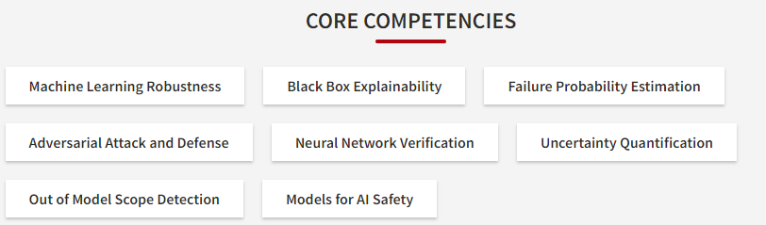
Reliable and Robust AI Systems
Understand the key assumptions underlying modern statistical machine learning, and identify situations where these assumptions can break down.
Apply techniques for improving model robustness, including data augmentation, distributionally robust optimization, and fine-tuning from pre-trained models
Evaluate models using explainability and failure identification techniques, including importance sampling for probability of failure estimation
Validate machine learning models, including using stochastic methods such as randomized smoothing, and formal methods such as neural network verification
Quantify uncertainty in machine learning models, including aleatoric vs. epistemic uncertainty, and apply common algorithms for estimating uncertainty

Slide 30
Factors Affecting AI Reliability
Data: AI systems rely on data to learn and make decisions, so the quality and quantity of data available can have a significant impact on their performance.
Algorithms: Different AI algorithms can be used to solve different types of problems, and the choice of algorithm can affect the accuracy and efficiency of the AI system.
Hardware: AI systems often require specialized hardware, such as graphics processing units (GPUs), to perform complex calculations at high speeds.
Human input: AI systems can be designed and trained by humans, and the quality of this input can affect the performance of the system.
Ethical considerations: As AI systems become more sophisticated and widely used, there are increasing concerns about their potential impact on society and the ethical implications of their decisions.
Regulations and laws: Governments and regulatory bodies may impose limitations or requirements on the development and use of AI systems.
Societal attitudes: The public's perception of AI can influence its adoption and impact.

Slide 31
Assignment 1:
1. Explain the Longstanding ethical questions firms will face with examples?
2. what are the factors that affect AI reliability.
3. Explain the possible AI use cases in Industries.
4. Explain any 3 AI models in detail.
5. What are the four types of AI based on Functionalities.
Submitted By: Mrs A R Kothimbire (AIDS Dept)

